Slide 1
Reminders...
You’ll use this file for the entirety of this capstone. Save it in a place where you can easily access it over the upcoming weeks.
You can edit and save this document in Google Drive
If you download this document, keep it in a place you can find it later
The content you put into this document will be used later
It is recommended that you do not skip any capstone readings
Feel free to customize this slide deck to make it your own, but make sure to answer all the questions in the prompts
Requirements:
Answer all the questions in this document
When complete, download this as a PDF document for submission in the peer review assignment.
Don’t know how to download as a PDF? You can find more information about downloading this by clicking here.
Remove this slide before submitting

Slide 2
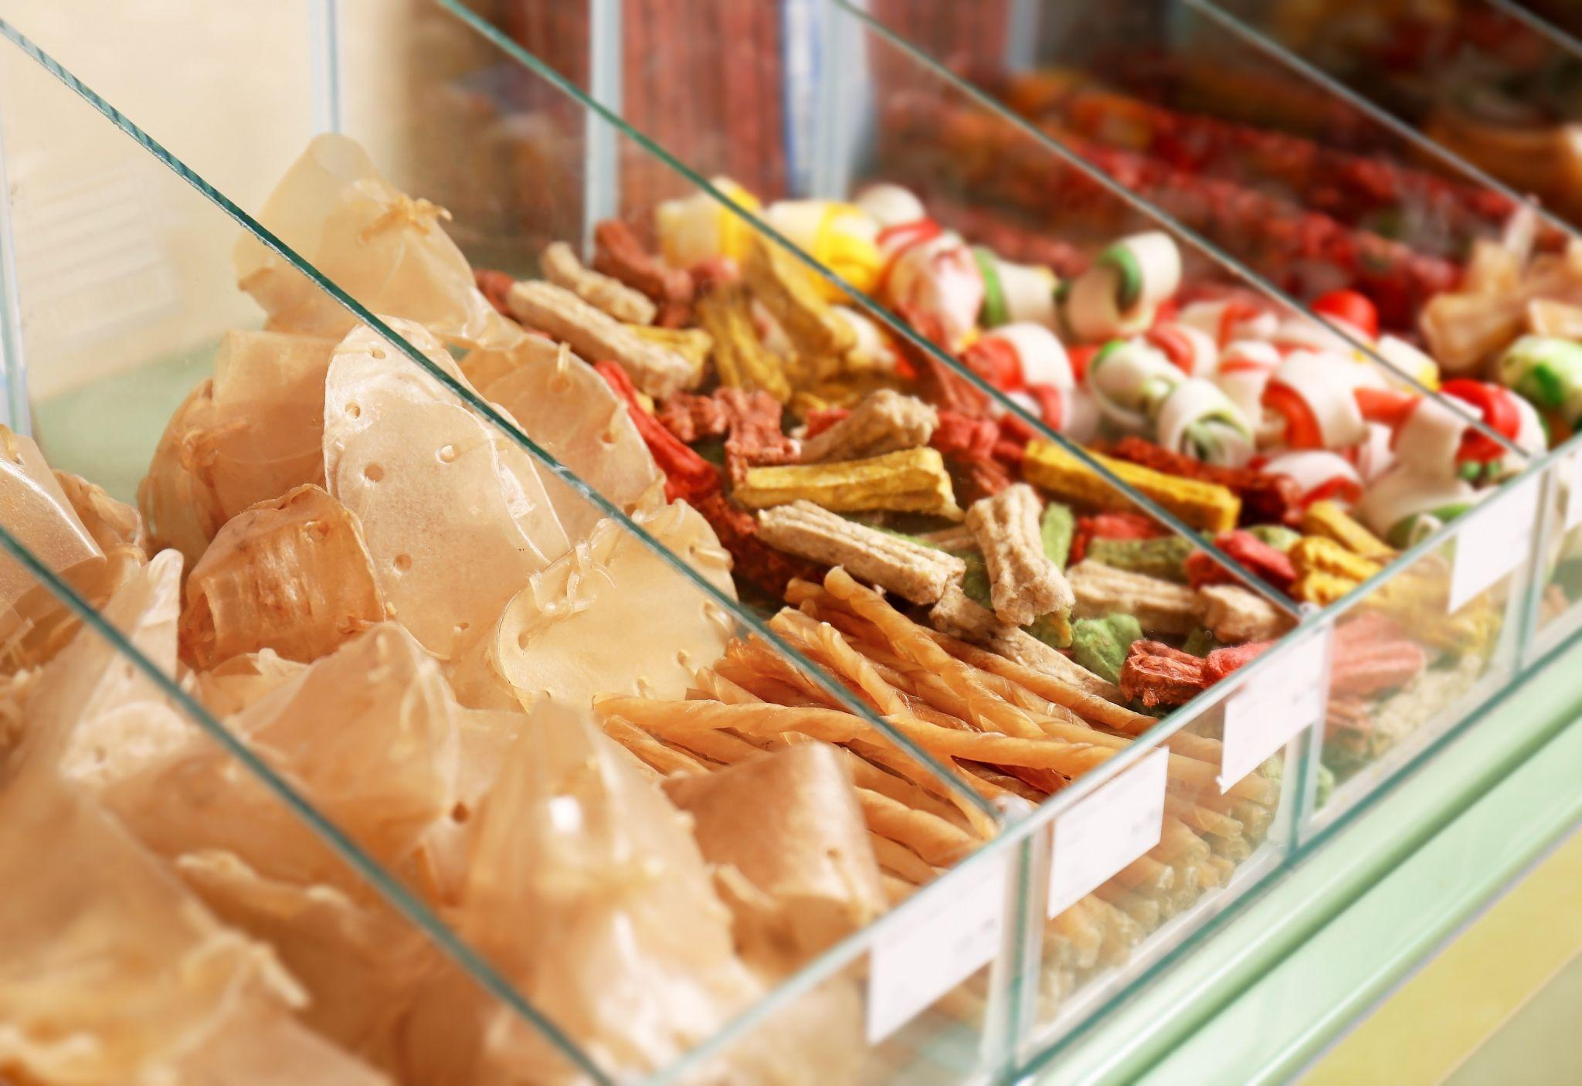

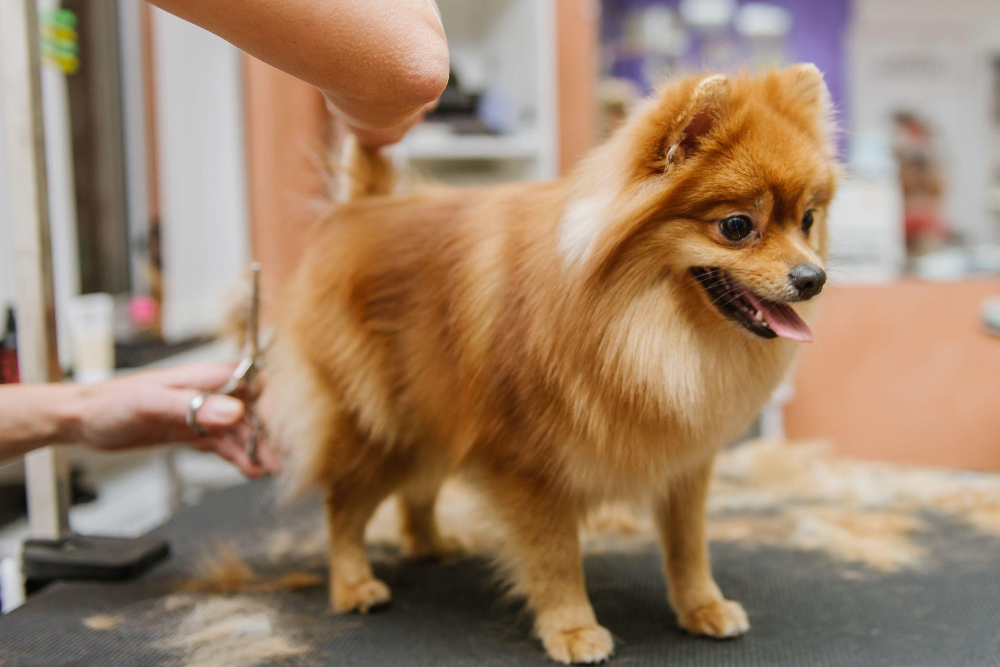

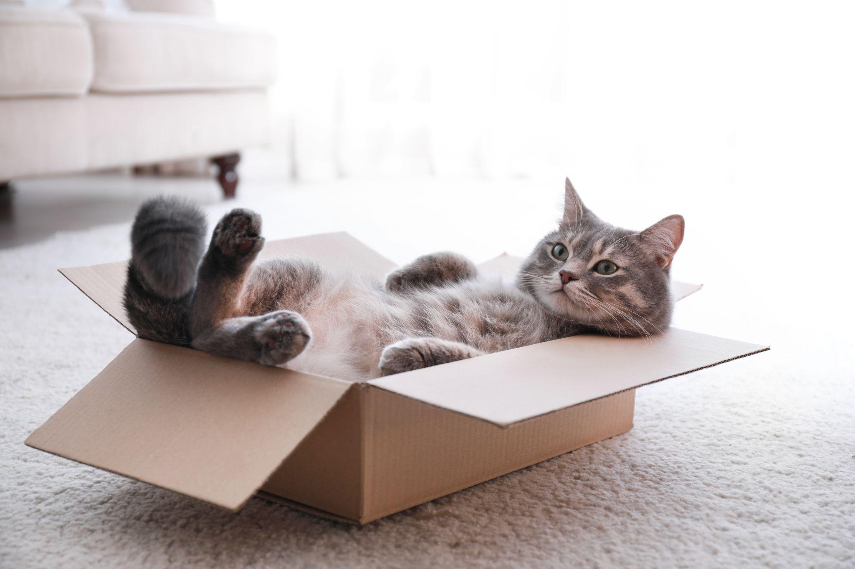
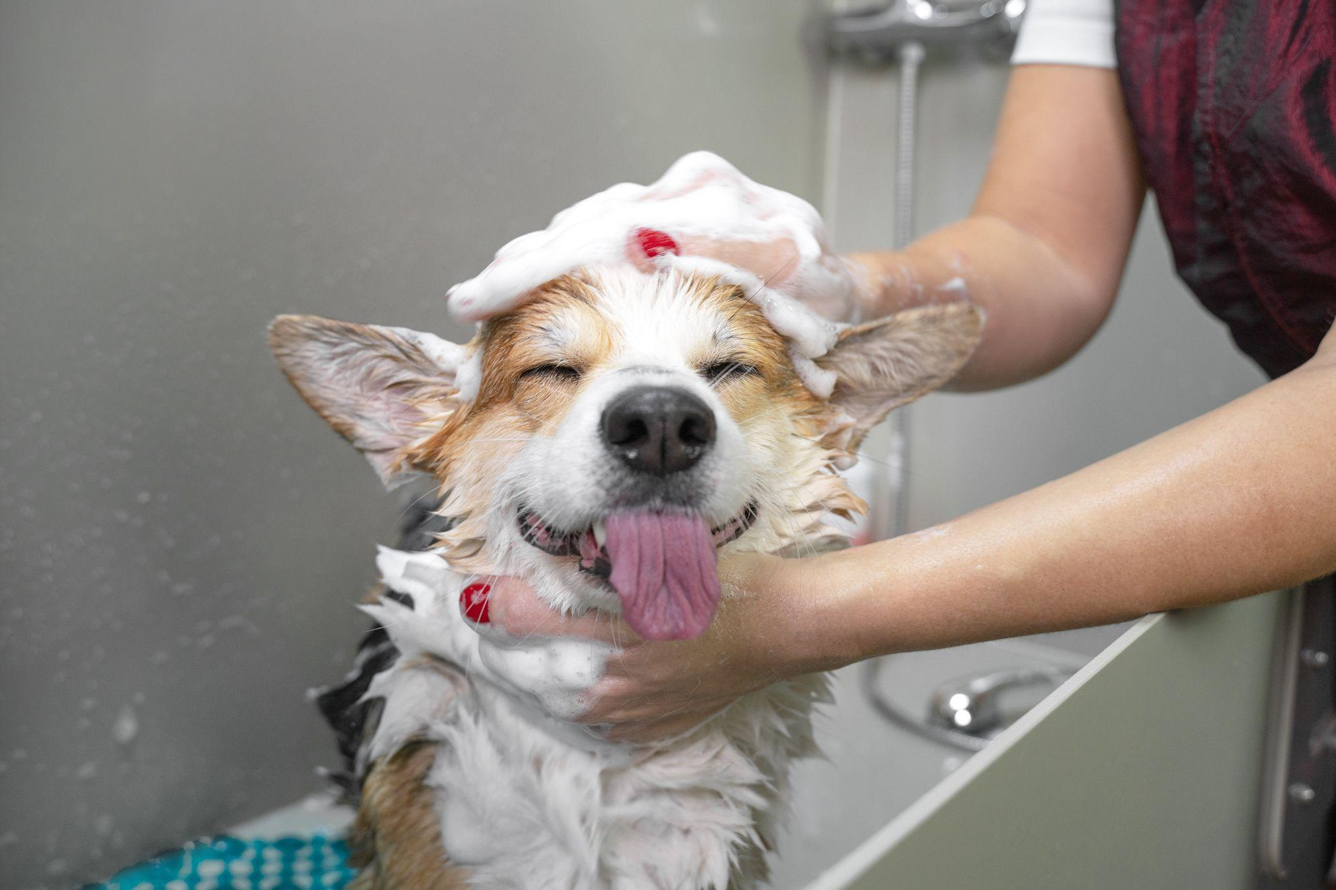


Images from Inu + Neko
Here are a few images that can be used throughout your deck that are part of the Inu + Neko image library.

Slide 3

Course 2 Capstone
The OSEMN Process

Slide 4
Your Approach 1 of 4
Give at least two example questions you would want to answer as an analyst that relates to Inu + Neko’s business problem.
Remember a good question includes a focus on something that is actionable and follows the SMART goal principles (specific, measurable, attainable, relevant, & timely).
What are purchases trend by month and days?
What are purchases made by title and categories?
What are the purchases quantities by ages?
What are total sales monthly and by categories?

Slide 5
Your Approach 2 of 4
What information do you think would be particularly important to your analysis for Inu + Neko?
Dates (trans_month and trans_day)
Cust_age
Trans_quantity
Prod_title and Prod_category
Total_sales

Slide 6
Your Approach 3 of 4
How would you go about gathering this information?
Look for first hand sources from Inu + Neko past purchases for last few years (2017-2020)
Liaise with other similar parties that have second hand sources for these data
Source from website or buy data if there is a possibility

Slide 7
Your Approach 4 of 4
What are some potential issues or roadblocks can you see in trying to get this information to address Inu + Neko’s business problem?
Legal and privacy issues of customer data
Data may be incomplete or missing
Potential of biases in data
Data entry mistakes
Data trustworthiness

Slide 8
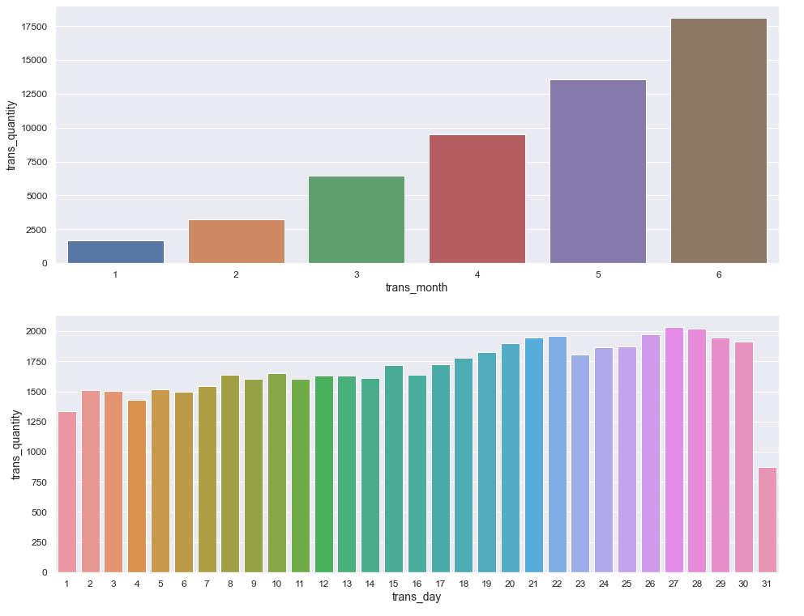
Your Data Visualization 1 of 4
Purchases Trend by Month and Day

Slide 9
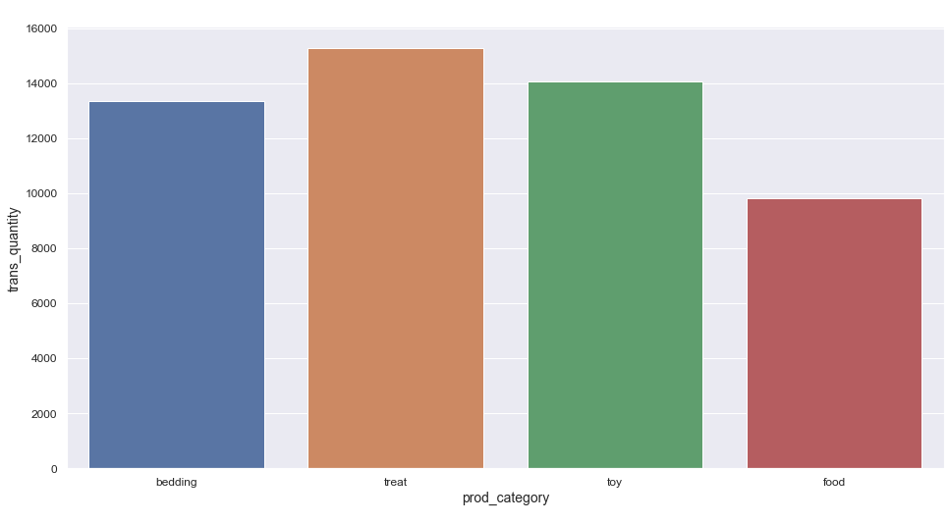
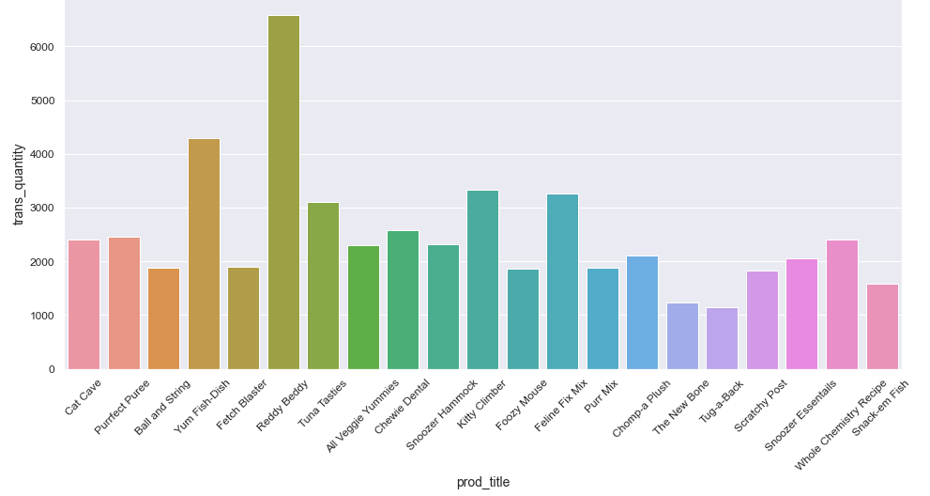
Your Data Visualization 2 of 4
Purchases by Category and Title

Slide 10
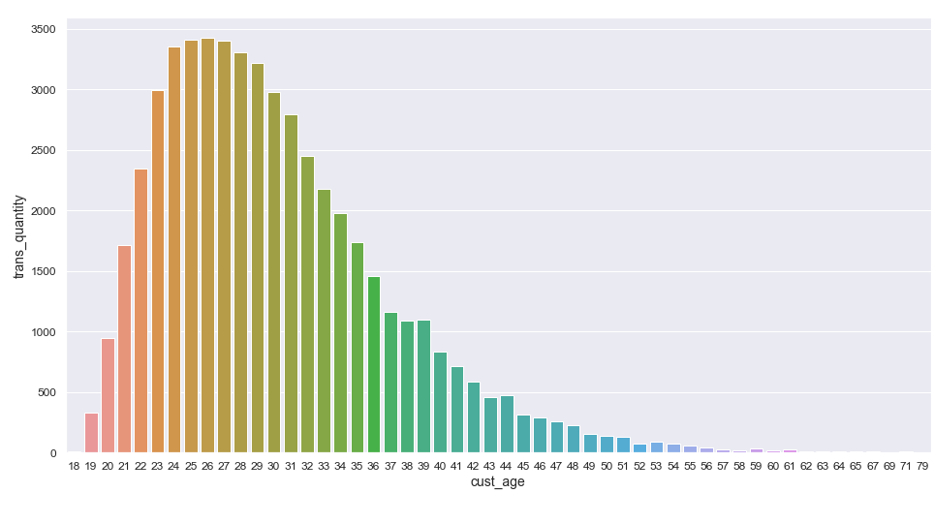
Your Data Visualization 3 of 4
Purchases by Age

Slide 11
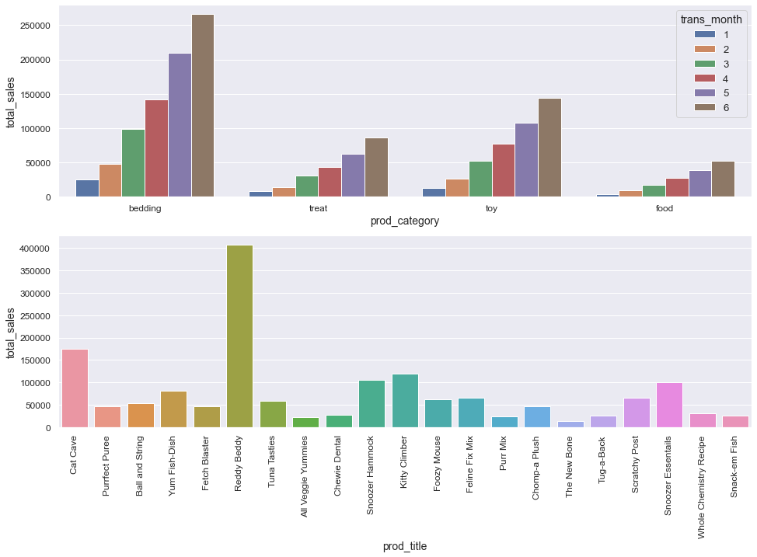
Your Data Visualization 4 of 4
Total Sales by Category (Month) and Product Title

Slide 12
Your Visualization Interpretation 1 of 2
What does this visualization show about the data?
Visual 1 shows purchases trending up each month. Purchases are high on day 20 to day 30 every month
Visual 2 shows cat & dog treats are highest purchase overall. Product Reddy Beddy is most popular purchase
Visual 3 shows customers in age range 22-33 purchased at least 2000 items in 6 months
Visual 4 shows bedding racked in mostly total sales with Reddy Beddy ranked number one ($400k) alone

Slide 13
Your Visualization Interpretation 2 of 2
Does this visualization align with what we’ve seen so far from the data?
Yes, absolutely.

Slide 14
Recommendations Based on Model Results 1 of 2
What recommendations would you give Inu + Neko based on the model results?
Focus on age group interest ( 22 to 33 ) range by marketing, promotions and surveying them to know what they like and fulfill their needs.

Slide 15
Recommendations Based on Model Results 2 of 2
What recommendations would you give Inu + Neko based on the model results?
To increase sales and revenue, the company can focus on top 5 categories and product titles in stocking and publicity. It will be good to mix and match them, offer bundle prices, offer discounts for bulk purchases or membership drive.

Slide 16
Your Final Insights 1 of 4
What can you say about the current state of the business?
Since there is an increasing trend of purchases every month in 2021, the potential to grow is there.

Slide 17
Your Final Insights 2 of 4
What projections can you make about the future state of the business?
A note of caution is we need sales data for the remaining July to December 2021 to give an overall picture to determine the future state of business.

Slide 18
Your Final Insights 3 of 4
What would you recommend to Inu + Neko?
An insight found is New York, New Jersey and Pennsylvania is top 3 performing states in terms of total purchases.
Inu + Neko need to investigate why these states have done well and apply it for future expansions.

Slide 19
Your Final Insights 4 of 4
What more work could be done to expand on your analysis?
(You won’t need to do this but state what would be good next steps for a follow-up analysis.)
It will be great to have past years of sales data for further analysis.

